Slide 1
So now we are digital, where do I stand and what do I do with all this stuff?
August 2, 2011
IDS conference
Matthew Sheehy
Harvard Library

Slide 2
Current status:
8.5 million items
450,000 new accessions per year
220,000 circulations per year or ~2.5%
122,000 sq. ft. (97,000 storage; 22,000 processing; 3,000 mechanical)
5 chillers (5.64M BTU/H)
6 boilers (3M BTU/H)
2 back-up generators (650 kW)
Water tank (250,000 gallons)
A pump house and storage shed

Slide 3
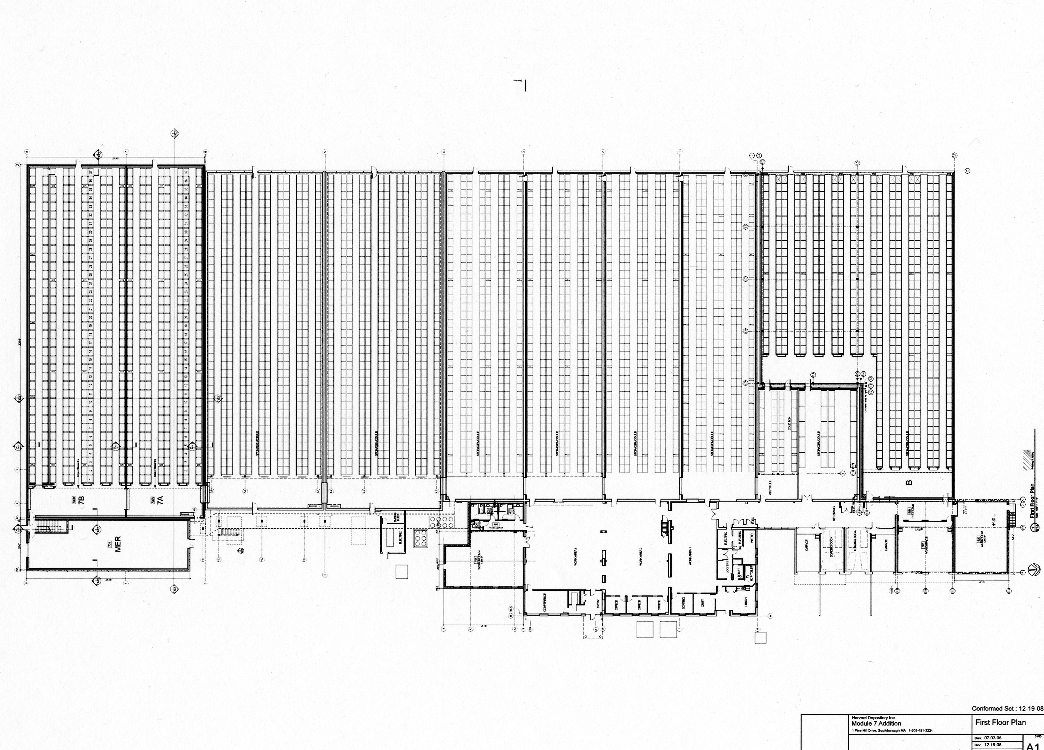

Slide 4
Environment Snapshot
Archival space: 50°-40°, 35% RH
Film: 40°, 35% RH
Records management space: Room temperature (50°-80°, no RH control)
Air completely exchanged 36 and 100 time a day.
Climate Notebook
Particulate and molecular filters in 8 of the 9 main air handlers.
Siemens Insight workstation

Slide 5
Security Snapshot
Optical smoke detectors (VESDA)
Leak detectors
Wet pipe sprinklers with 250,000 gal. heated water tank (4 hours)
Motion detectors, glass break detectors interior and exterior door sensors, CCTV, “virtual fence”

Slide 6
What Do We Ask Ourselves Next?
Structural decisions
Collections
Services

Slide 7
Structure
Oldest structure is 25 years old
Changes in building technology
Throwaway buildings versus maintenance
Changes to preservation standards
Standards/environment set points

Slide 8
Structure—Energy Usage
Post-environmental change (archival space)
40°-50° (3%) RH 35% (5%)
Winter months:
50% reduction gas
35% electric

Slide 9
Collections
What should we really be keeping here?
How long do we need this stuff?
How long does society need this stuff?

Slide 10
Collections
Are we a library of record?
If we are not a library of record, but a research library, we must be current and think about the future of scholarship. Consent faculty engagement.
Noted comment – A French book from decades ago that is used for a dissertation. Knowing that book is there forever is comforting, but has the book’s usefulness been fully exploited by the research and is keeping it sentimental?

Slide 11
Collections
Being true to the mission (erring on the side of conservative – hard to go back)
What a public statement like any of the above might do to our reputation

Slide 12
Service/User Expectations
Delivery options (Cornell, 1 mile; Brown, 4 miles; Chicago, on site)
When does print stop mattering and we just store what we have?
Storage curve prediction
Staying true to the University – are we serving the needs of current research, future research, or are we part of the larger information ecosystem?

Slide 13
Ideas Being Considered
~1 mega-watt PV solar array (about to award contract – commissioned ~December 2011)
Solar thermal
Heat reclamation of desiccant wheels
Rain and grey water reclamation
Shortening service hours (currently 2 overlapping shifts)
Out-sourcing records management
Stricter control over accessions

Slide 14
More Ideas Being Considered
Greater investment in building envelope
Less investment in building envelope
Automated retrieval systems
Automated sorting
Low-oxygen environment
More holistic approach to construction
Collaborative space/regional trust

Slide 15
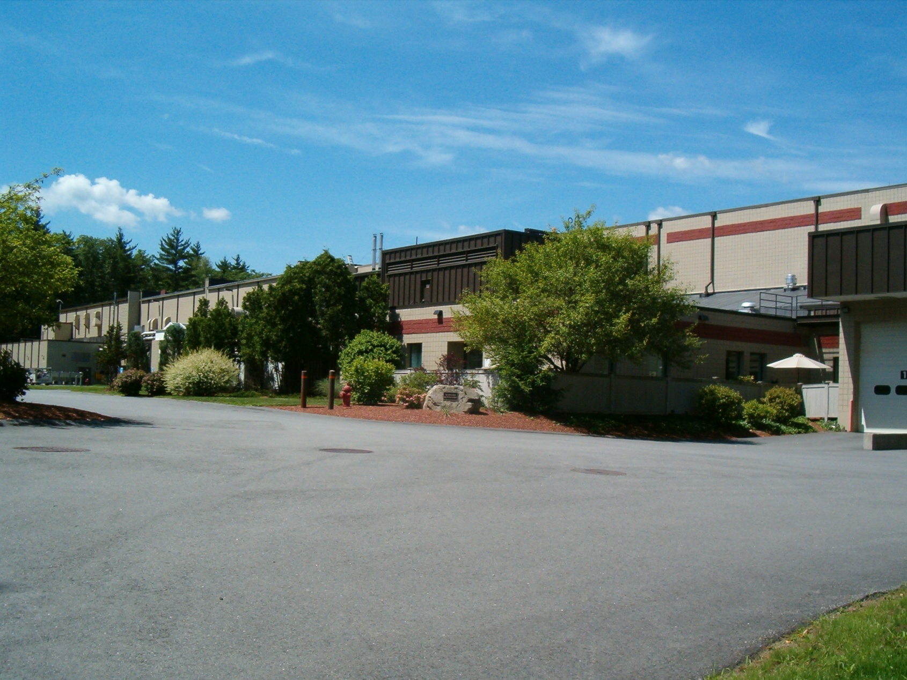

Slide 16
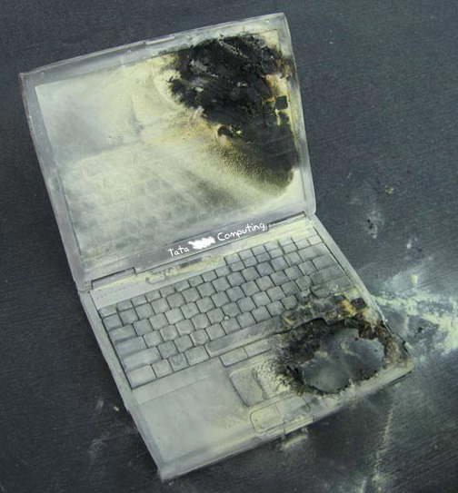

Slide 17
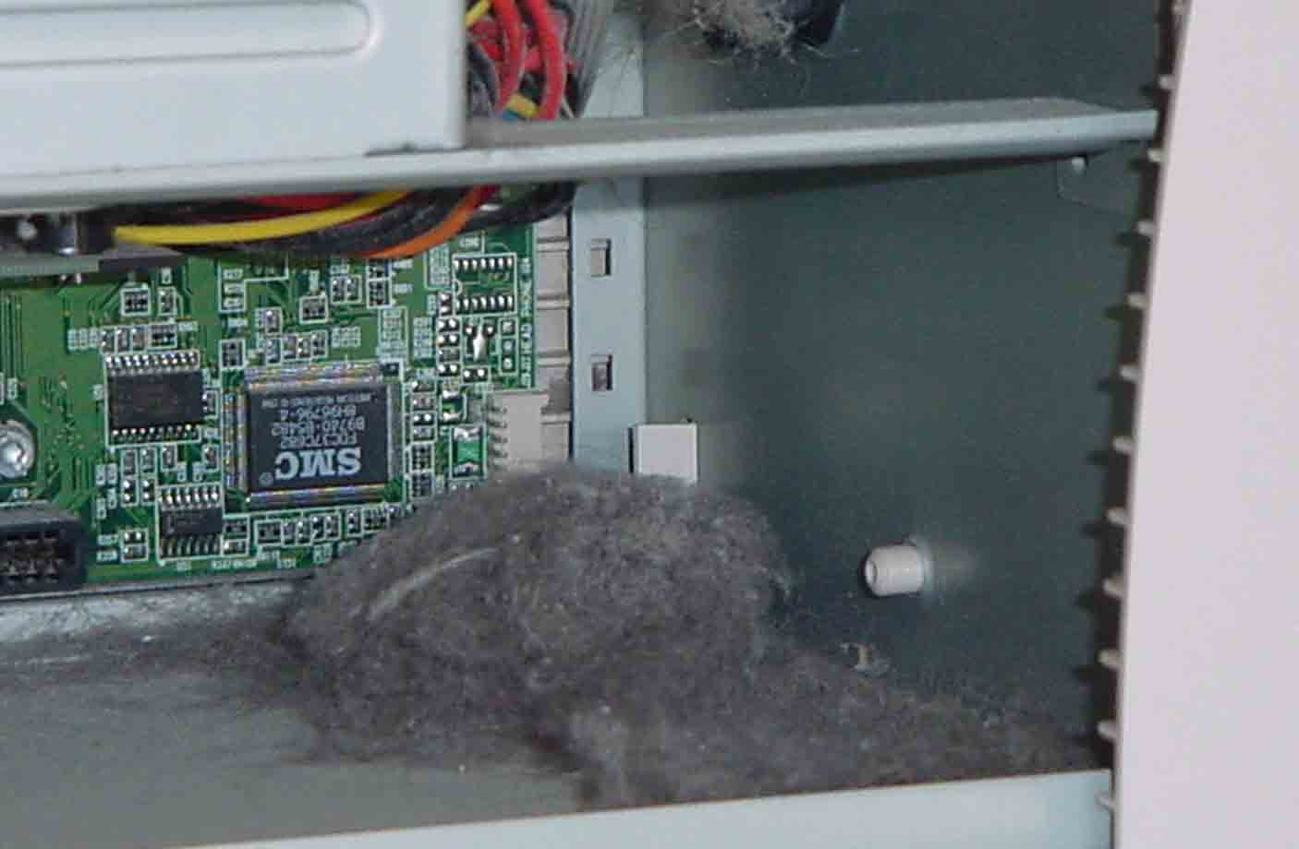

Slide 18
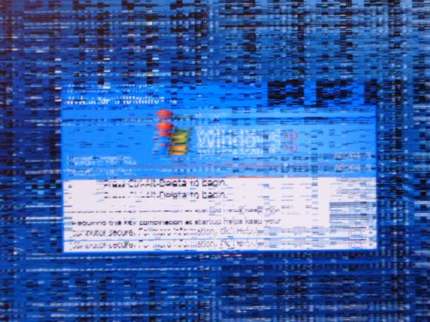

Slide 19
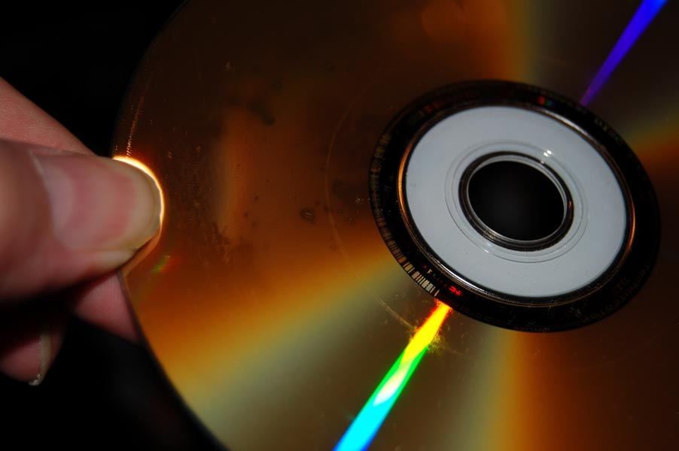

Slide 20
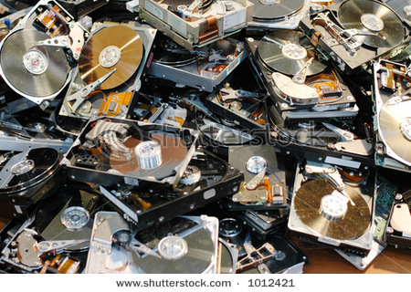

Slide 21


Slide 22
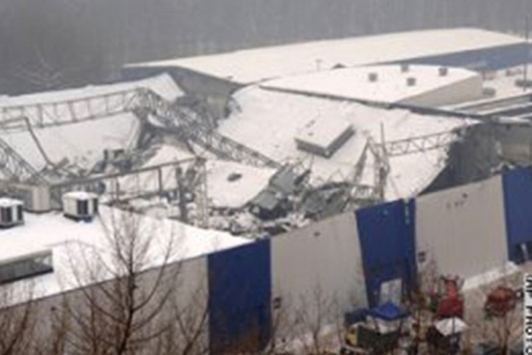

Slide 23
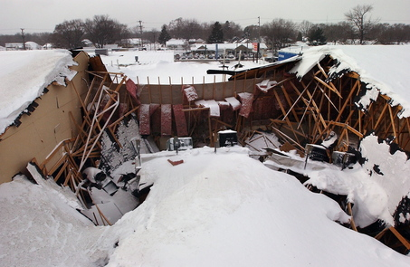

Slide 24
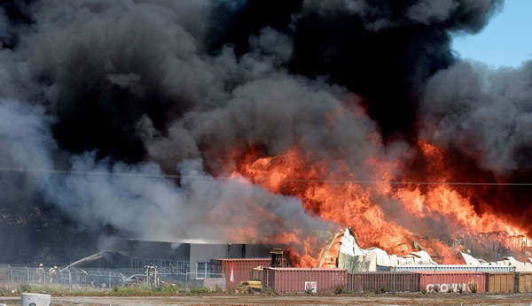

Slide 25
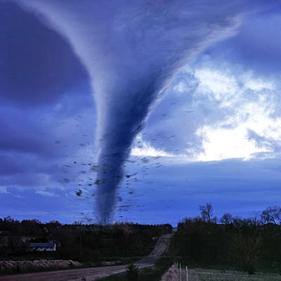

Slide 26
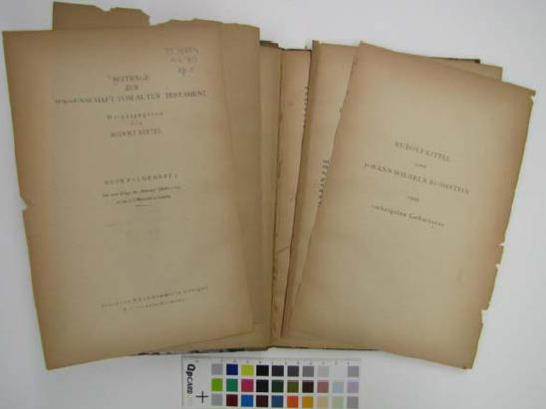

Slide 27
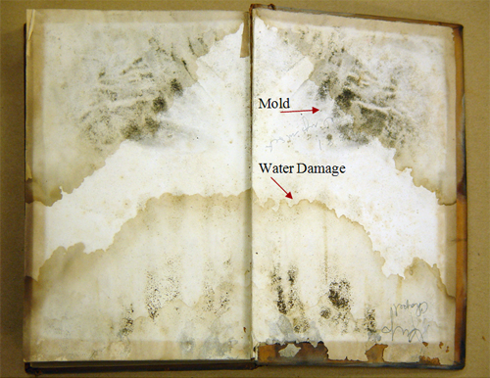

Slide 28
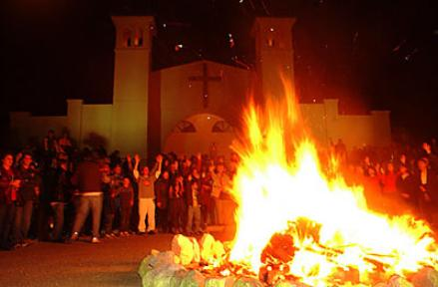

Slide 29
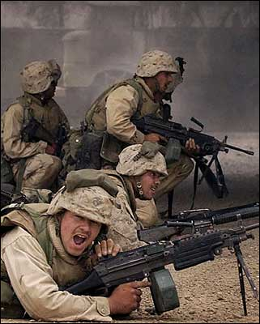

Slide 30
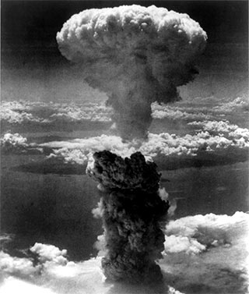

Slide 31
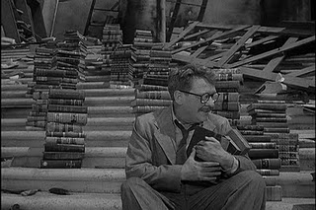

Slide 32
Thank You
matthew_sheehy@harvard.edu

